Slide 1
Navigating
For Job Seekers (Module 1)
Setting Up a New Account

Slide 2
Setting Up a New WorkinTexas.com Account:

Slide 3
Setting Up a New WorkinTexas.com Account
Setting Up a New WorkinTexas.com Account
Complete basic registration information
Enter comprehensive background information
Tip: Gather all the information you will need and allow enough time to complete these tasks. This information may include social security and driver’s license numbers, any citizenship or veteran-related dates and ID numbers, and education and employment history dates and contact information.

Slide 4
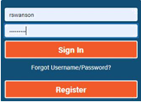
Setting Up a New WorkinTexas.com Account
To create a new account:
On the WorkinTexas.com home page, in the upper right corner, click the Register button (see figure below).
Under Option 3 – Create a User Account, click Individual.
Follow the steps and fill in all required fields (marked by a red asterisk *). When the “What would you like to do next?” page displays, you are registered.

Slide 5
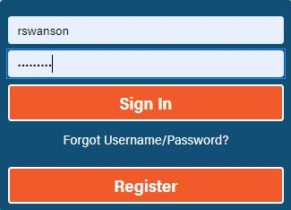
Setting Up a New WorkinTexas.com Account
Signing In to Your WorkinTexas.com Account
• On the WorkinTexas.com home page, in the upper right corner, enter your Username and Password, and then click the Sign In button. Your Individual Workspace will appear.

Slide 6
Setting Up a New WorkinTexas.com Account
Updating Your General and Background Information
To simplify tasks later when using WorkinTexas.com, it is important to ensure the information about yourself and your skills, education, and employment history is up-to-date. This information is used to create résumés and job applications.
1. From the Quick Menu, click My Portfolio My Individual Profiles Personal Profile
2. Make any desired changes on the General Information tab.
3. Make any desired changes on the Background tab by clicking the Start the Background Wizard link to step through each section

Slide 7
Conclusion

