Slide 1
Information session
January 20, 2022
Notes:
We are so pleased to have you joining us for today’s information session about XXXX!
This session will provide an overview of our workforce system, the many pieces that come together to allow us to serve employers and individuals in the Gulf Coast region, and specific information about what we look for in contractors. Our goal is for you to leave with helpful information, so there will be plenty of time at the end of this presentation for Q&A at the end.
Again thank you for being here.

Slide 2
Early Education Quality
Notes:
The subject of today’s information session is the Financial Aid Payment Office, which is a critical piece of our workforce system. We will discuss its purpose and function in detail later in this presentation.
But first, let’s dig into Workforce Solutions – who we are and what we do.

Slide 3
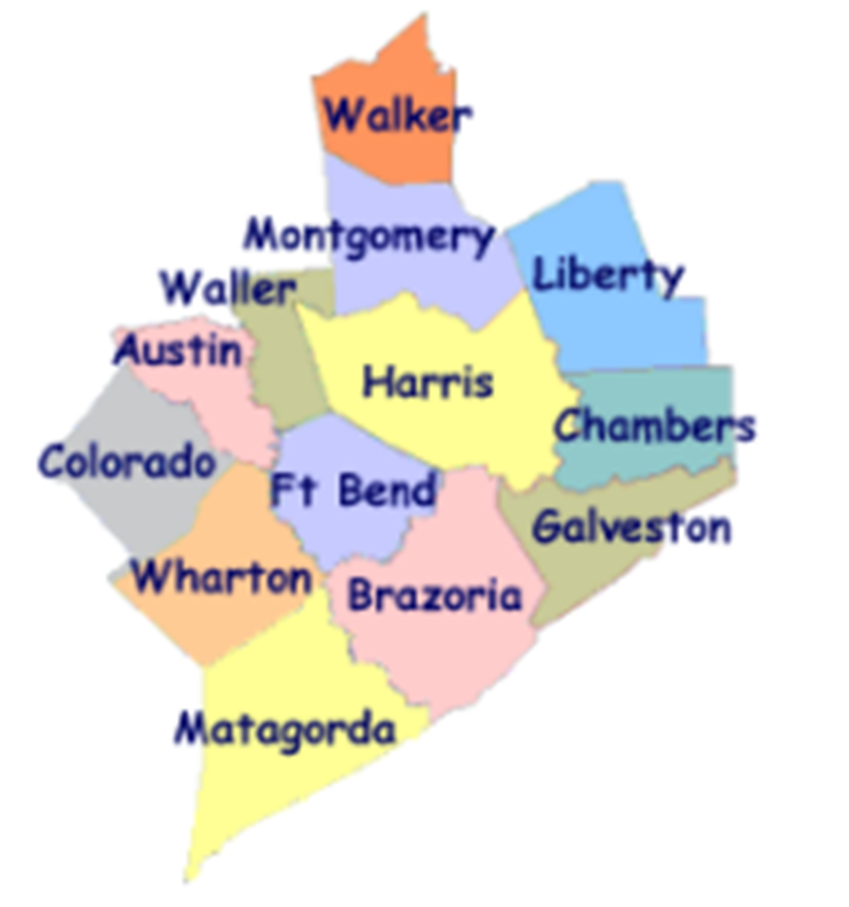
Workforce Solutions
ABOUT US:
Gulf Coast Workforce Board – Workforce Solutions is the public workforce system serving the 13-county Gulf Coast region
We elevate the economic and human potential of the Gulf Coast region by fulfilling the diverse needs of the employers and individuals we serve
What we can do:
List and fill open jobs, including HR consulting
Offer career advice and job placement assistance
Support individuals with their education and training needs
Provide work-based learning opportunities
Support families with early education financial aid
Assist individuals with disabilities with education and job opportunities
Notes:
The Gulf Coast Workforce Board and its operating affiliate Workforce Solutions are the public Workforce system in the 13-county Houston-Galveston region.
Business-led and community-focused, the Workforce Board sets the region’s Workforce agenda and the strategic direction for the Workforce Solutions system.
The Houston-Galveston Area Council (H GAC) is the Board’s staff, serving as the system’s corporate home office and providing management of and direction to sub-recipients that operate within the Workforce Solutions network.

Slide 4
Workforce Solutions
PURPOSE
To keep our region a great place to do business, work and live.
MISSION
We elevate the economic and human potential of the Gulf Coast region by fulfilling the diverse needs of the businesses and individuals we serve.
VISION
Our region attracts and retains the best employers, affords everyone the dignity of a job, remains vitally important to the global economy — and all within it are thriving.
VALUES
We Are Employer-driven
We Care Passionately
We Take Responsibilities Seriously
We Imagine Possibilities
Notes:
Part of understanding who we are as a system, is knowing our purpose, mission, vision, and values.
Our purpose is to keep our region a great place to do business, work, and live.
PURPOSE
To keep our region a great place to do business, work and live.
MISSION
We elevate the economic and human potential of the Gulf Coast region by fulfilling the diverse needs of the businesses and individuals we serve.
VISION
Our region attracts and retains the best employers, affords everyone the dignity of a job, remains vitally important to the global economy — and all within it are thriving.
The values that guide our behaviors as we execute our purpose, mission, and vision are:
VALUES & BEHAVIORS
We Are Employer-driven
We Care Passionately We Take Responsibilities Seriously We Imagine Possibilities
Advocate for others Be accountable Seek multiple perspectives
Inspire hope Bring fresh thinking Follow up and follow through
Fuel progress Drive results Engage one another in making a difference

Slide 5
A meaningful impact
Notes:
We expect these efforts to result in more competitive employers, a better educated workforce, more and better jobs, and higher incomes.
Workforce Solutions helps employers meet their human resource needs and individuals build careers.
We deliver direct service to businesses and people throughout the region. Our system is all about making the labor markets that impact our region work more efficiently for employers and workers. We do this by identifying and filling imbalances or gaps between supply and demand in an effort to keep our region the best place to do business, work and live. Our entire system works to provide employers, individuals, educators, students, and parents with up-to-date and useful information on opportunities for growth, good wages, and future careers.

Slide 6
2021 Impact
24,600 employers and 428,000 individuals served
Spent at least $13.3 million on scholarships for more than 3,400 individuals in high-skill, high-growth occupational training
Supported nearly 22,000 families and 42,000 children with early education subsidies
Helped more than 69,800 individuals go to work
Raised the incomes of 32,747 by 20 percent or more
Helped 76.6% of individuals pursuing a post-secondary education attain a credential (certificate or degree)
Notes:
Workforce Solutions knows that our region is more than just a point on a map. It is the home of millions of people and the location of thousands of businesses. And the relationship between those two is what keeps our region bustling with activity and rich in promise. When we identify and pursue every opportunity to bring vibrancy to the labor market, we generate more promise and hope. Our region becomes a magnet for amazing businesses and amazing talent. People flock here for jobs and businesses rush for opportunities to grow. We become a place where businesses and people want to plant their roots because they see a bright future here. Abundance follows, and as a result, we become an even more important player in the world economy and all in our region thrive.
This philosophy has produced the following results over the past year (read bullets)

Slide 7
How We Do It
Notes:
Workforce Solutions creates this impact by helping employers meet their human resource needs and supporting individuals as they build careers.
We deliver direct service to businesses and people throughout the region.
Our system is all about making the labor markets that impact our region work more efficiently for employers and workers. We do this by identifying and filling imbalances or gaps between supply and demand in an effort to keep our region the best place to do business, work and live.
Our entire system works to provide employers, individuals, educators, students, and parents with up-to-date and useful information on opportunities for growth, good wages, and future careers.

Slide 8
Pieces of the System
Employer Service
Career Offices
Financial Aid Payment Office
Financial Aid Support Center
Texas Workforce Commission Integration Management Team
Youth Service – Next Gen
The Regional Team
Regional Quality Assurance Team
Staff Training & Development
Education Opportunity Consortium
Early Education Quality (Childcare)
Vocational Rehabilitation Services
Veteran Staff
Notes:
We know that individual’s job needs can best be met by meeting employers’ needs for a well-educated and well-trained workforce; therefore, the local workforce system has two principal components:
Our Employer Service division provides information and markets and sells service to employers.
Our Career Offices provide a pathway to an array of information, resources and opportunity for residents of this region.
Workforce Solutions is committed to being employer-driven -- you heard it mentioned when we covered our values. Employer service is the lead component in the delivery system, with employers as the primary customer. This is the case because it is the employers that drive the volume, diversity and timing of opportunities we can offer the individuals we serve.
Though we have two principal service components, our Workforce Solutions system has many interconnected pieces that must work together to deliver our services. The Board procures contractors for the operation of each of the pieces of the Workforce Solutions, which include (read bullets)

Slide 9
EARLY EDUCATION QUALITY

Slide 10
Our Vision for Early Education Quality
Provide a safe and learning environment for children while their parents work or go to school
The Workforce System envisions the future of this work as a hybrid of in person and online services possibly operated by two contractors –
How we do it – Part One/ TRS and other quality support
How we do it – Part Two/ Community Awareness, Family Support and Training
Notes:
We know that individual’s job needs can best be met by meeting employers’ needs for a well-educated and well-trained workforce; therefore, the local workforce system has two principal components: an employer service component that provides information and markets and sells service to employers, and a “people” component that offers access to an array of information and workforce service to Gulf Coast residents. Employer service is the lead component in the delivery system, with employers as the primary customer.

Slide 11
How we do it – Part one Texas Rising Star and Other Quality Supports
The Early Education Quality contractor will work closely with the Gulf Coast Workforce Solutions system, childcare providers, and other community resources to introduce and manage Texas Rising Star (TRS) programs in our area.
Our TRS programs involve a commitment to quality childcare and the improvement of early education for children that exceeds the state’s minimum childcare licensing standards in various categories.
Notes:
Director and Staff Qualifications, Orientation, and Training •
2. Teacher-Child Interactions • Teacher interactions that support child development and social-emotional learning
3. Group size and staff-to-child ratios •
Program Administration and Management
Family education and involvement •
7. Indoor/Outdoor Learning Environments perform the services and make those services available to parents and providers.

Slide 12
How we do it – Part One
Training, Development and Planning
Targeted training for TRS providers
Provide opportunity for provider to achieve CDA and AA professional level early childhood education
Staff participation in trainings and certifications
Texas Rising Star Outreach and Management
Introduce, manage and enroll area providers into the Workforce Solutions system and TRS
Quality and Service Improvement – Focusing On:
School readiness
Provider incentives
Notes:
TRS
• Manage enrollment and providing technical assistance for providers with TRS Pre-Star designation
• Enter accurate data on TRS providers in Children’s Learning Institute (CLI) Engage
• Increase and maintain number of TRS providers in the region
• Provide quality improvement and TRS assistance to area providers
• Manage state enacted professional development for the board and childcare providers
• Assess and mentor providers using qualified assessors and mentors.
Quality and Service Improvement
Improve care specifically for infants and toddlers
Provide early learning and school readiness opportunities for provider staff and parents with children birth through pre-kindergarten
Work with childcare providers to improve school readiness and increase early learning and literacy
Provide support for programs which provide school readiness, early learning, career awareness and literacy
Provide childcare staff with stipends for eligible educational milestone and quality benchmarks

Slide 13
How we do it – Part One
Program Support
Supports childcare administrators in creating director and staff accounts in Texas Workforce Registry
Reporting/Measurement/Monitoring
Measuring and reporting on school readiness activities
Reporting progress on childcare quality activities throughout the year
Notes:
Reporting/Measurement/Monitoring
Measure school readiness outcomes for children in TRS programs by selecting and using approved child assessments programs/tools
Reporting progress on monitoring of data for school readiness outcomes quarterly to H-GAC liaison
Reporting quarterly progress on training and assistance provided to “at risk” providers

Slide 14
How we do it – Part Two Community Awareness, Family Support and Training
Referral, Consultation, Needs Assessment, Coaching
Provides parents with parent information on early education and childcare, referrals, and consumer education
Work on Pre-K partnerships and Contracted Slots
Training, Development and Planning
Provide and develop community training to providers when identified or requested by board or sub-recipient
Coordinate and facilitate training for childcare conferences and meetings
Quality and Service Improvement
Work on providing quality service for children with disabilities
Expand and work on improving infant and toddler care
Work with WFS At-Risk and pre-star providers to become TRS
Notes:
Referral, etc…
Provide Early Education and Childcare information and referrals, and consumer education to parents/families across the service region, including 2-1-1 Texas
Partner with Pre-Kindergarten, Head Start/Early Head Start and TRS providers to serve eligible families for Board reserved childcare contracted slots
Telephone consultations and resources to registered and listed home providers
Provide Parenting sessions on site at childcare centers
Collaborate with Adult Education contractors to provide educational services to families
Provide technical assistance to parents requesting immediate need for available childcare options in the event of unforeseen events, e.g. pandemic, flooding, etc.
Training
Provide various levels of training for provider staff on site and virtually
Coordinate services such as teacher training, when possible with public school districts, Head Start, Early Head Start and Early Childhood Intervention programs and others to expand the availability of quality training to teachers.
Facilitate training sessions at conferences for childcare providers such as (Texas Association for Education of Young Children and Gulf Coast AEYC, Harris County Department of Education, CHILD)
Perform development and training on topics such as child growth development, math and science development, social and emotional development and responsive teaching techniques
Arrange for provider training on children’s health and safety, child abuse prevention, early learning and child development for infants and toddlers

Slide 15
How we do it – Part Two
Secures and manages local match funding which increases the availability of early education resources and direct childcare assistance for families in the service region.
Technology
iPads in the classroom for TRS providers to use when being assessed remotely
Traditional web-based platforms for training remotely – ZOOM, TEAMS, etc
Interested in technology that could help providers and staff perform more efficiently

Slide 16
Part of the Franchise
Workforce Solutions units and contractors work together in an integrated fashion to deliver high-quality service for our customers and achieve the Board’s results. Each contractor is responsible for ensuring work that is linked and integrated with other contractors gets carried out efficiently.
Early Education Quality currently works directly with the following WFS teams:
The Financial Aid Payment Office
The Financial Aid Support Center
Adult Education
Employer Service
Notes:
FAPO
Pays for supportive services by vendors and trainers
FASC
To identify families that may need child care for children with disabilities
Adult Education
Offer families accessing an AE service/training the ability to talk with someone about quality care ( what to look for ) and if not eligible for WFS which providers may still fit their need.
Employer Service
Hiring Events for staffing

Slide 17
How we do it – Part Two
Performance Requirements
Performance and Production Requirements
See chart
Operation Process Requirements
A Look at the Current Data
Staffing/Budget Details
82.5 total direct operations staff (includes 50 mentors/assessors*)
7,750,000 Total contractor budget FY22 (operation costs)
$12,000,000 Total budget includes supportive services and contractor costs
12.6% ($974,949 for administrative costs)
565 TRS 2-4 Centers
137 pre-certification status
Notes:
Both State and Board targets – chart available
Operation Requirements
Have an infrastructure that can facilitate work and staffing involved in carrying out the responsibilities outlined in the contract
Have staffing Chart Available
TWC has told board that they will begin managing the Assessor position for the state during FY22

Slide 19
Questions
Notes:
What questions can we address for you today?

Slide 20
What’s Next

Slide 21
Workforce Solutions
Contracting With Us
An RFP will be extended in the coming weeks.
If your contact information changes, please reach out to Deborah Duke (Deborah.duke@wrksolutions.com) to share updates.
For more information about Workforce Solutions, visit www.wrksolutions.com.

