Slide 1

Required posters
January 2024

Slide 2
Public areas

Slide 3




Core Values

Slide 4

I AM Workforce Solutions

Slide 5
Veteran’s Stand-Up
Near the front of the office

Slide 6

Dress the Part Stand-Up

Slide 7

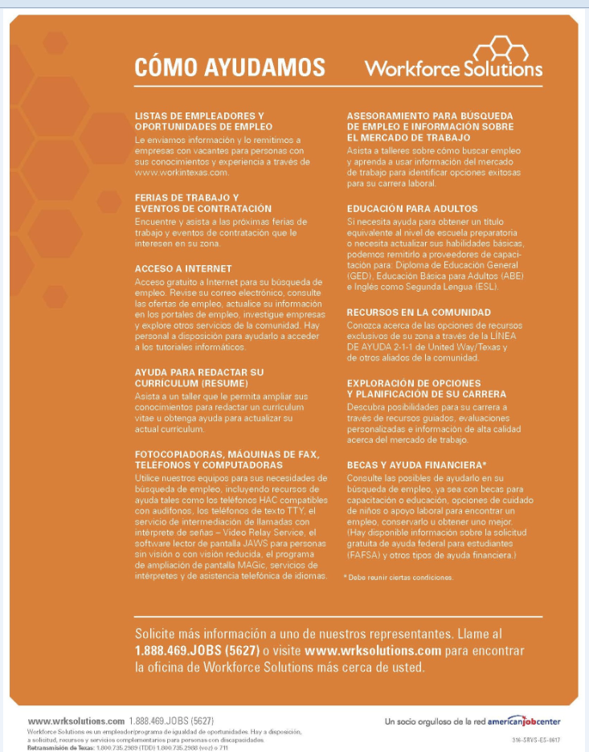
Services

Slide 8
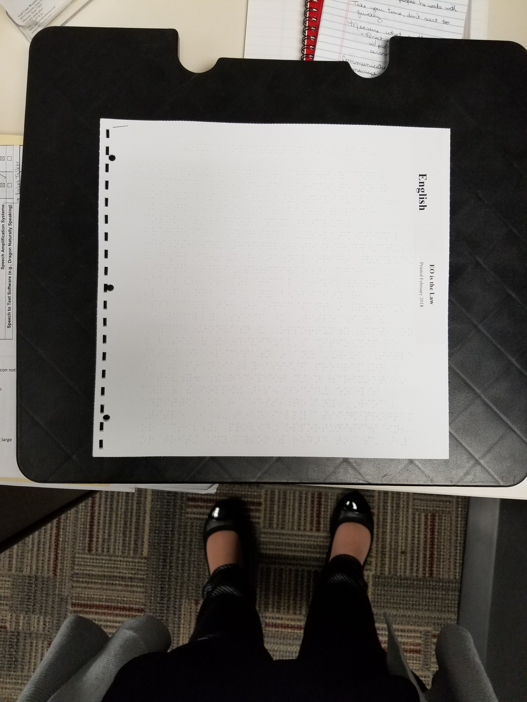
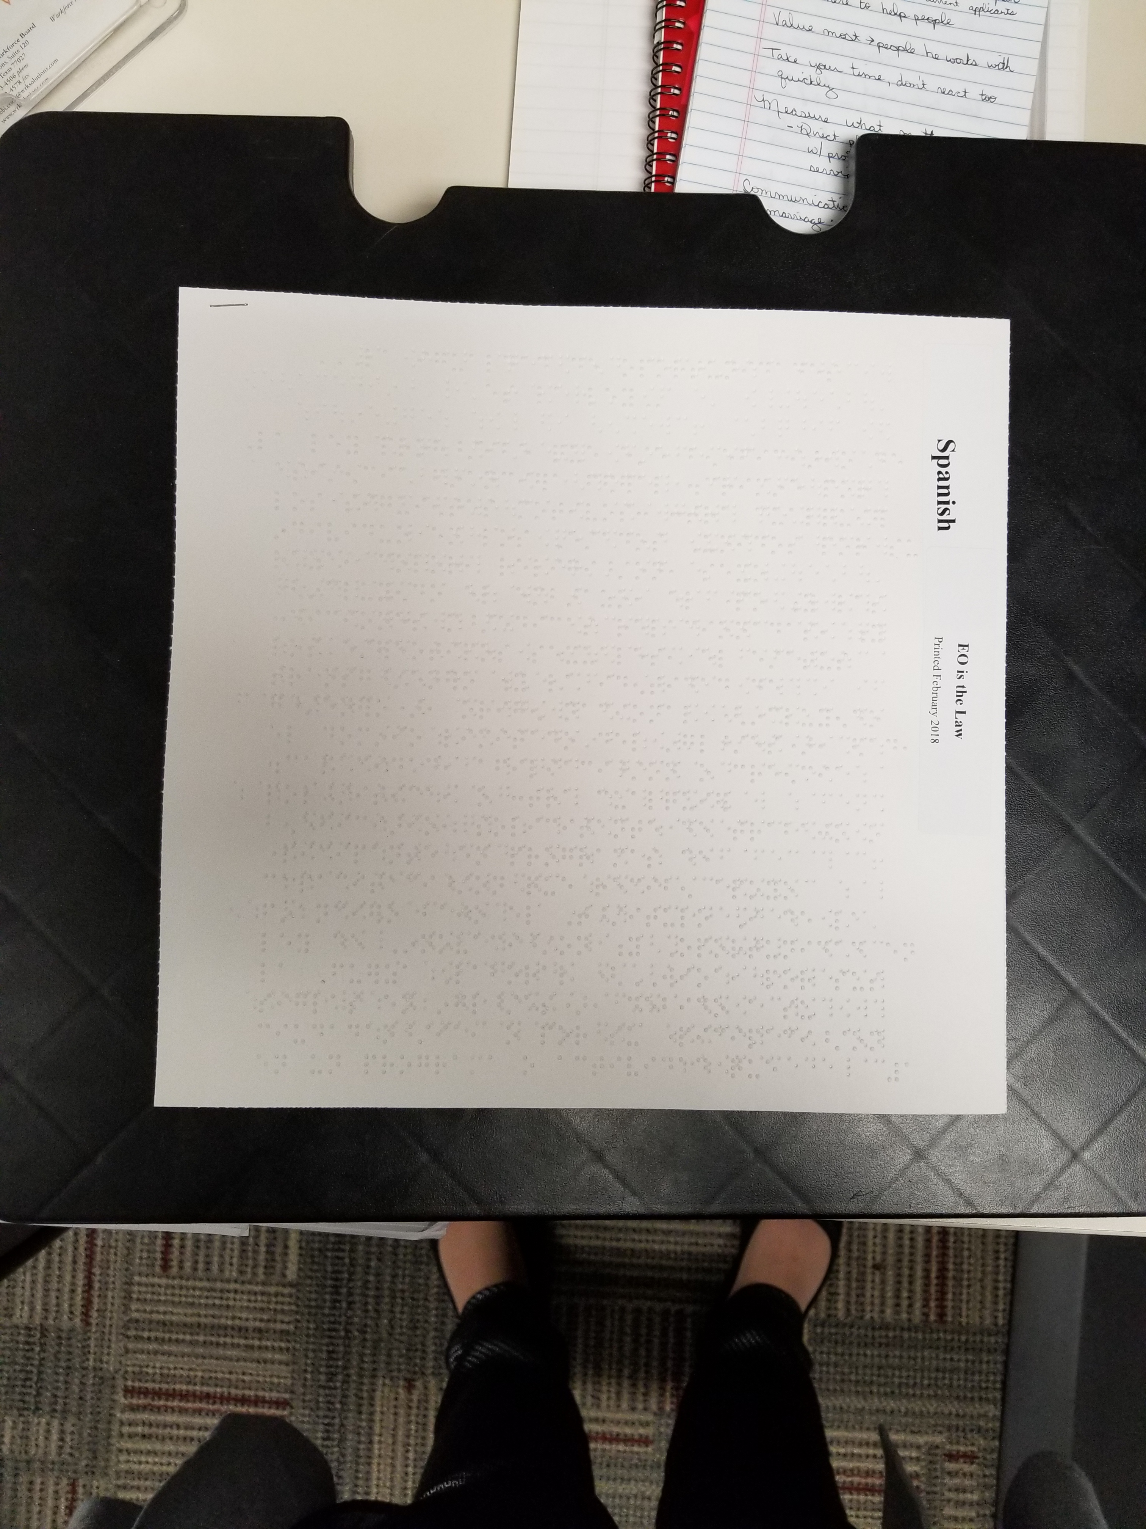
Braille WIOA EO is the Law Notice
At the
Greeter’s station

Slide 9
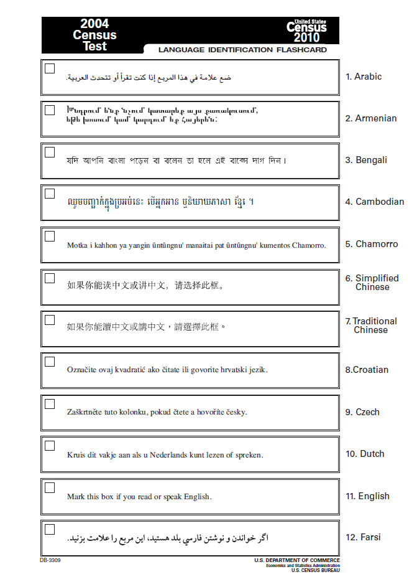
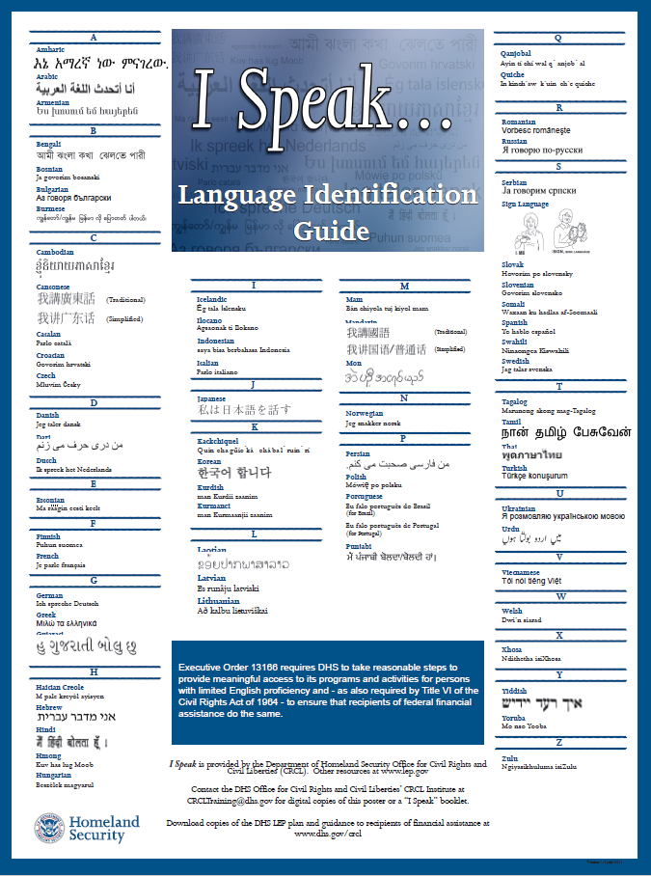
I Speak Cards
At the
Greeter’s station
Either version may be used

Slide 10
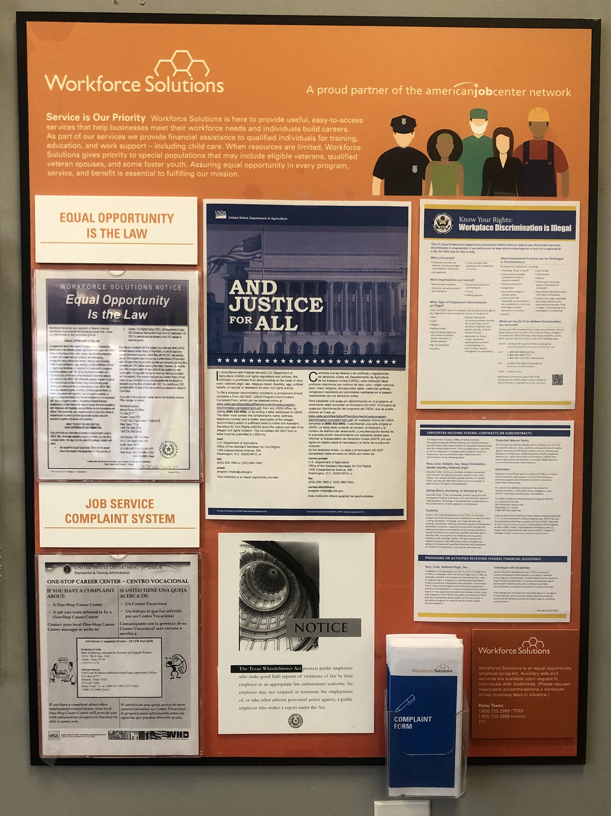
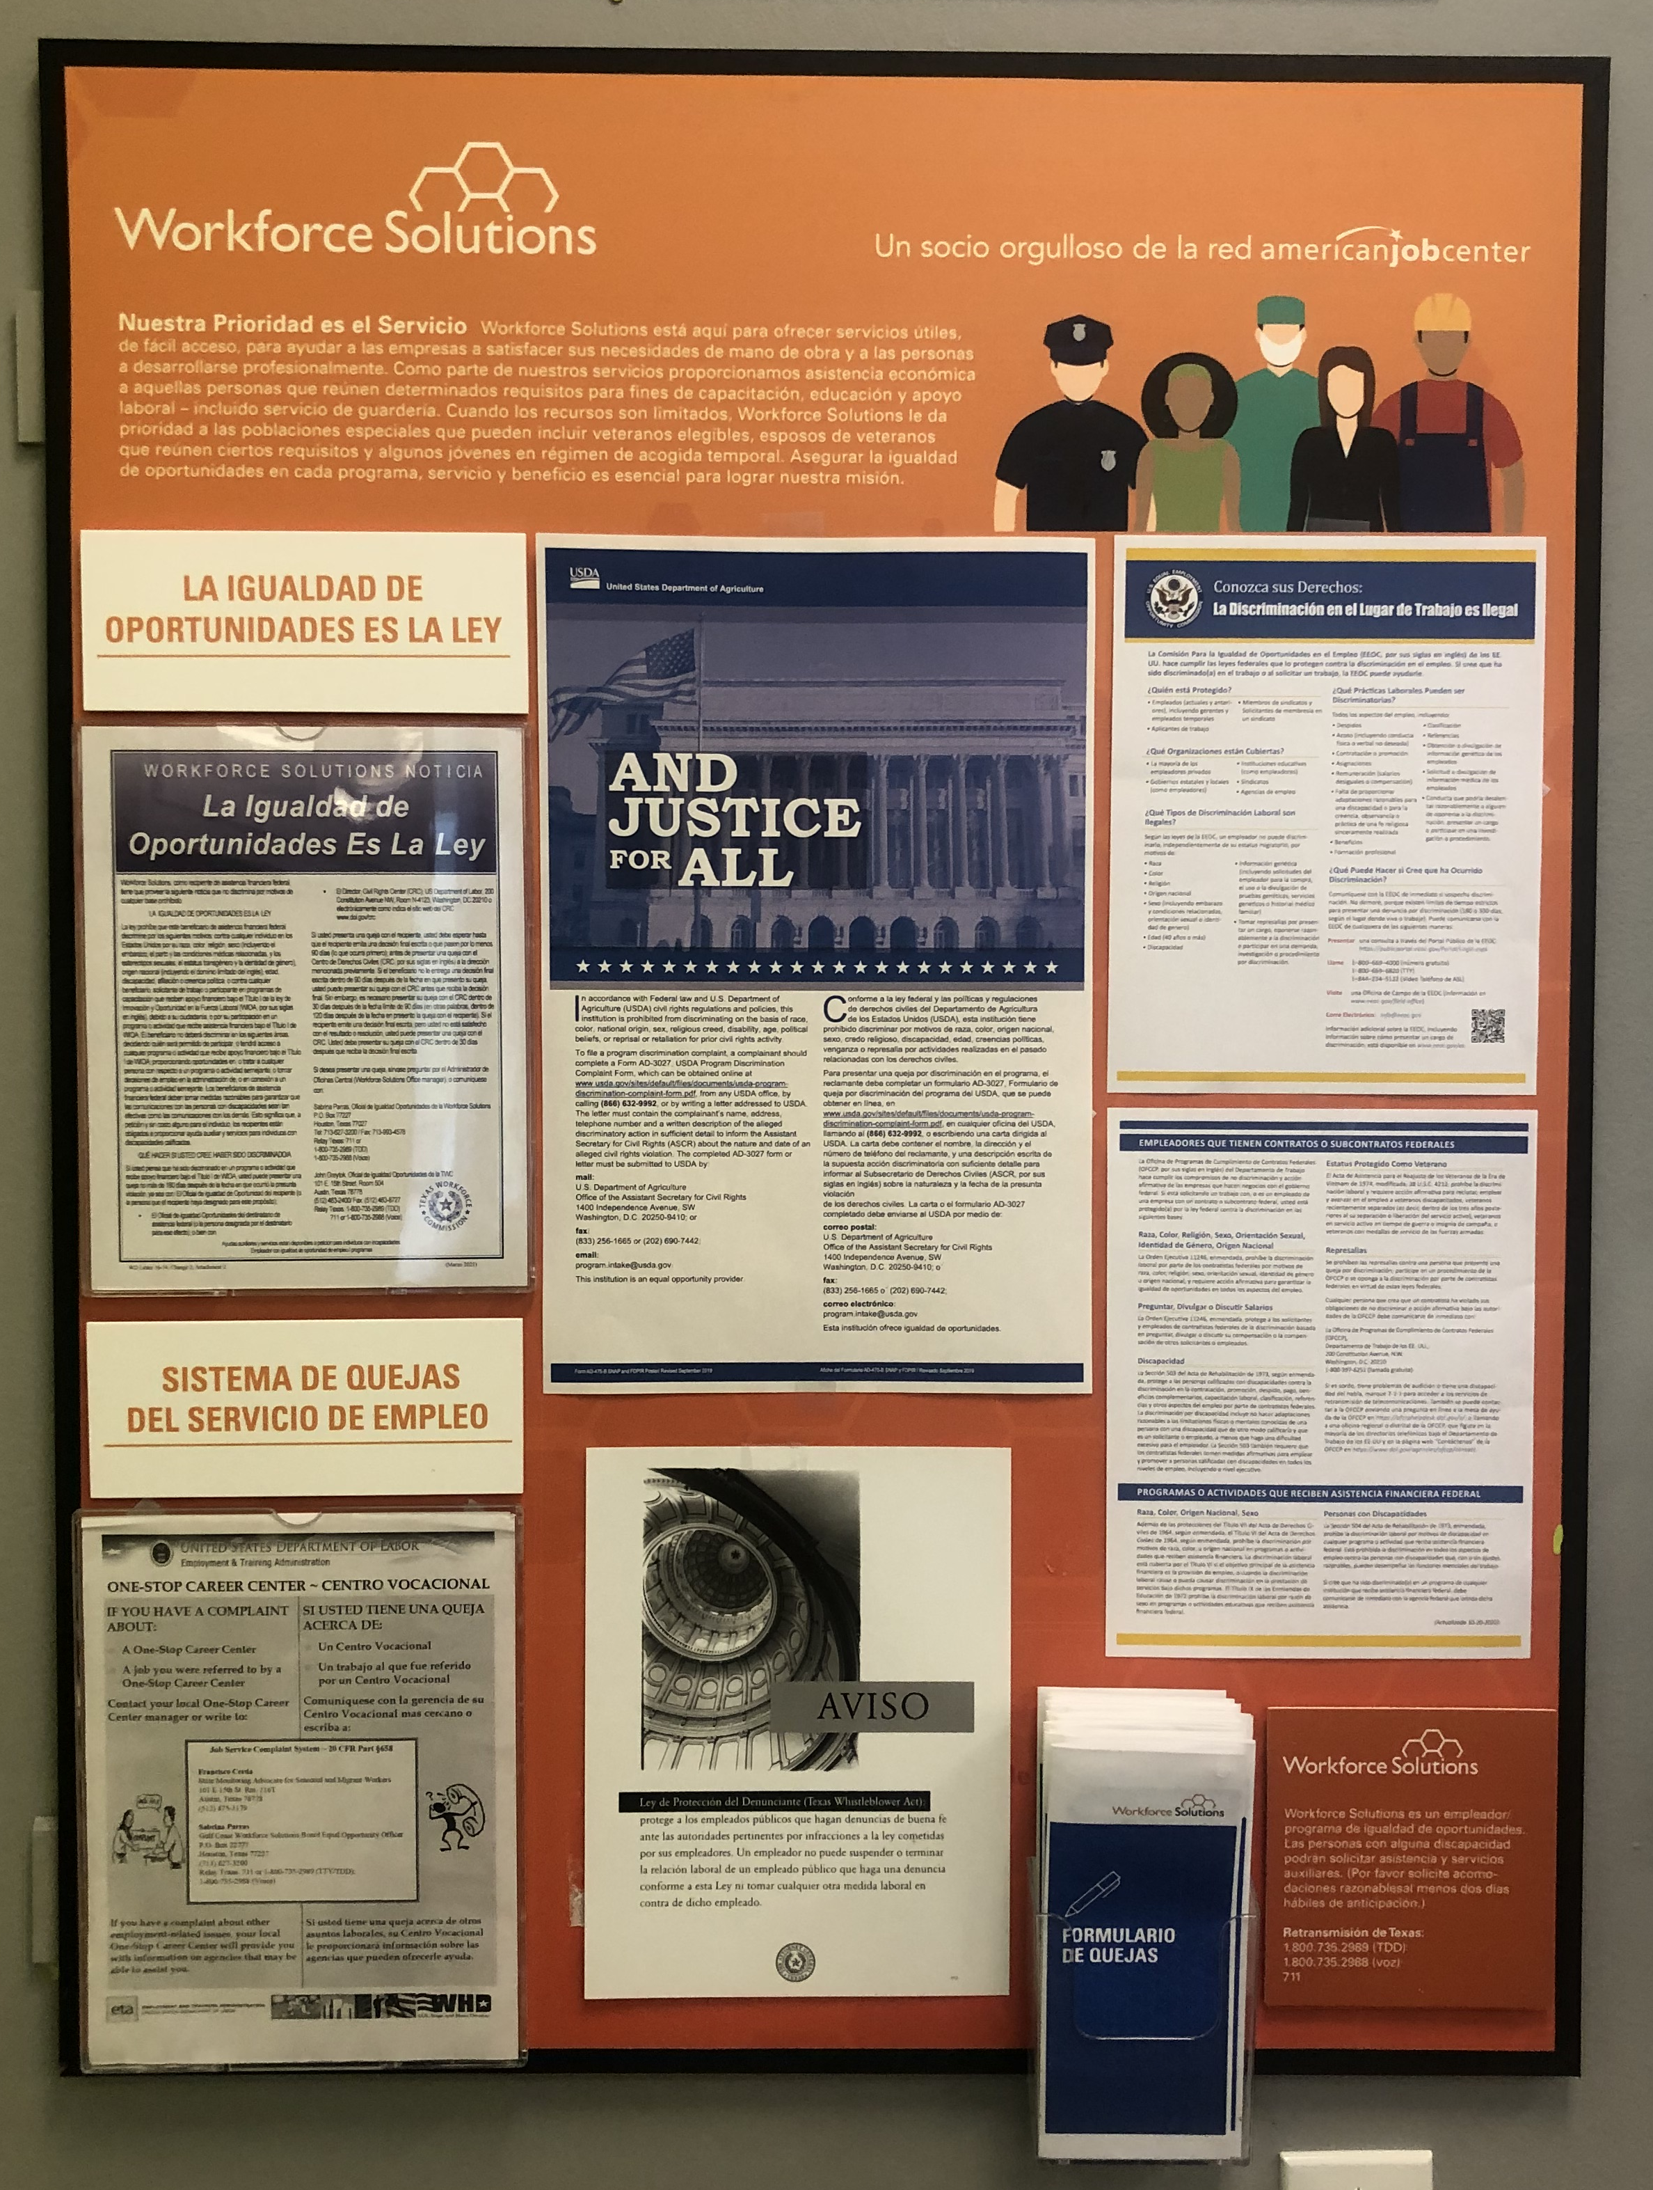
Equal Opportunity Board

Slide 11

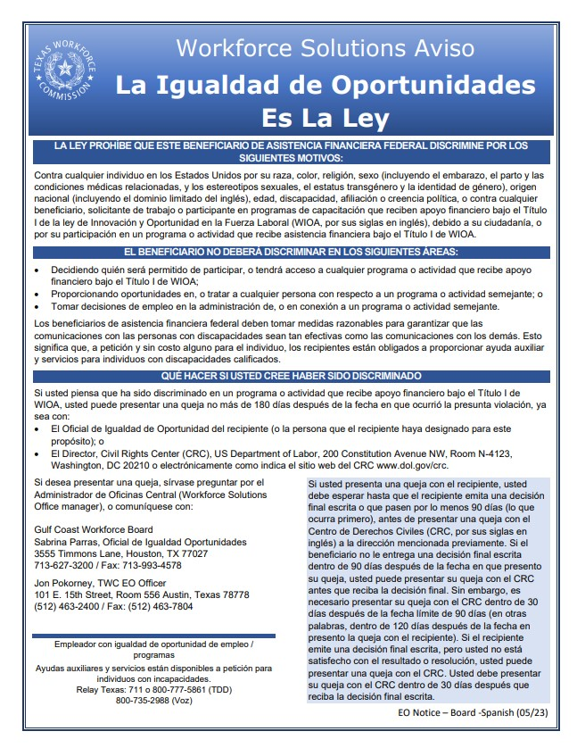
WIOA Equal Opportunity is the Law
(EO Board)

Slide 12
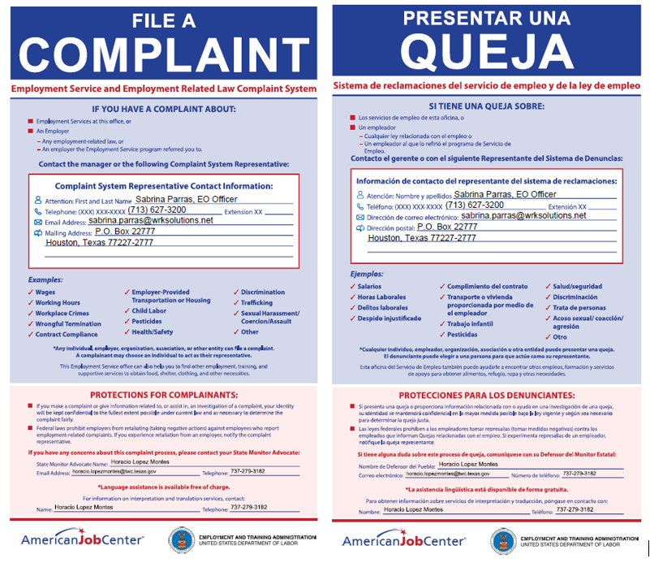
ES and Employment Related Law Complaint System with Contact Information – Replaces Job Services Complaint System (EO Board)

Slide 13

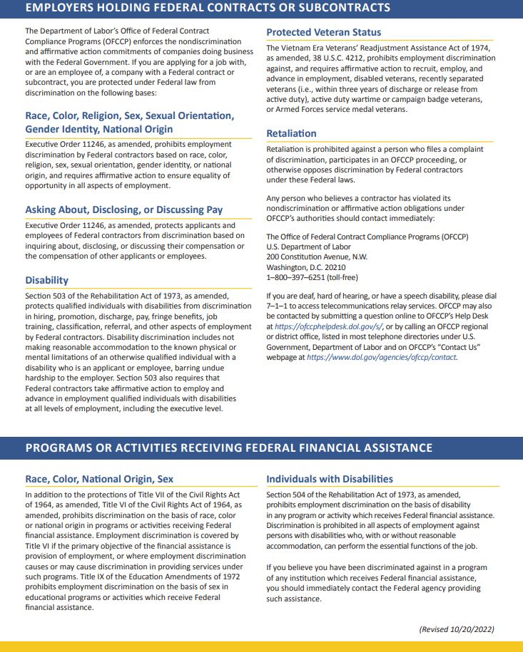
Know Your Rights
(EO Board)
Notes:
Spanish EO Board

Slide 14

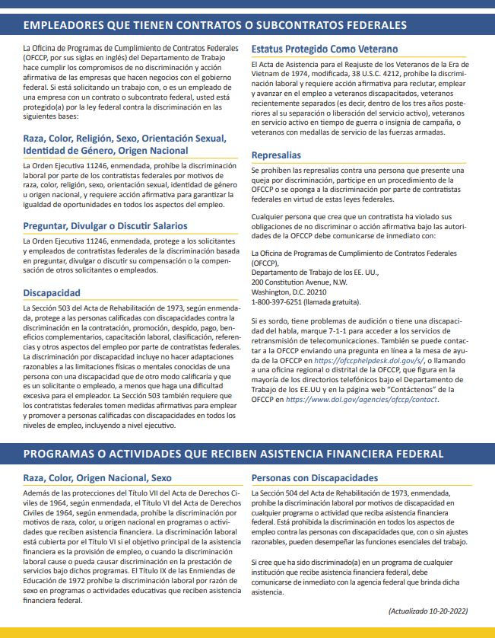
Know Your Rights
(EO Board)

Slide 15

SNAP E&T - Justice For All
(EO Board)

Slide 16
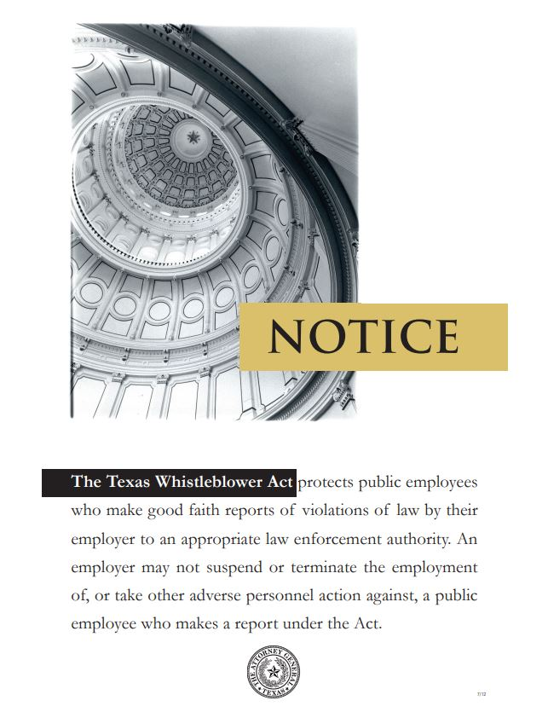

Whistle Blower Act
(EO Board)

Slide 17

Volume Control Pictogram
At public telephones

Slide 18

TTY Pictogram
At
TTY machine, near video phone, and near public phones

Slide 19

Video Relay Service
Near
TTY machine,
at video phone,
&
near public phones
September 2018

Slide 20
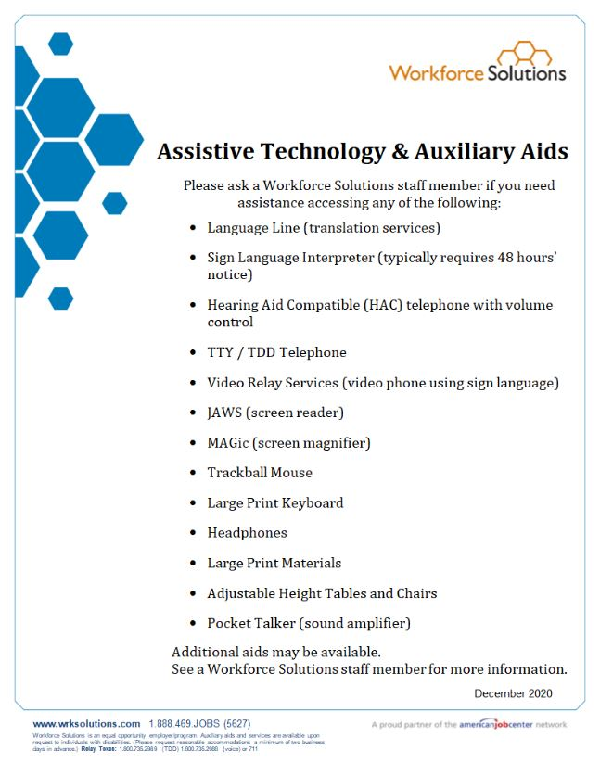
Assistive Technology & Auxiliary Aids
At each accessible workstation, TTY machine, & video phone
Notes:
update

Slide 21
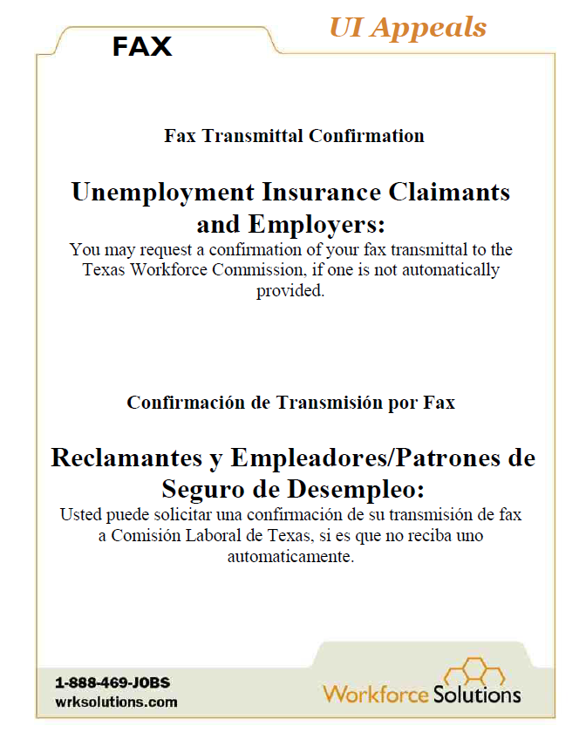
Unemployment Insurance Appeals
Fax Confirmation
At each Resource Room fax machine

Slide 22
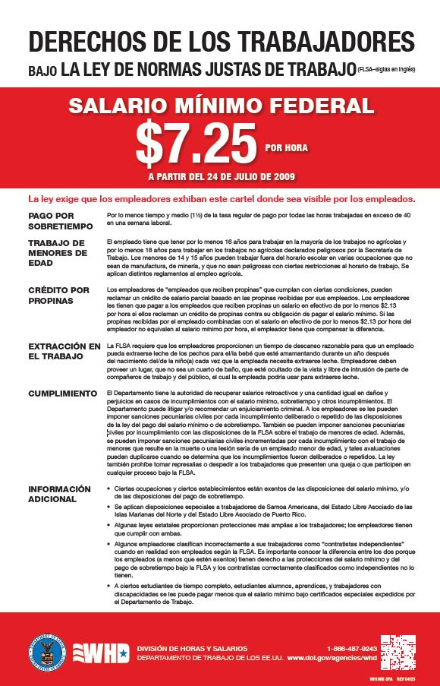

Fair Labor Standards Act

Slide 23
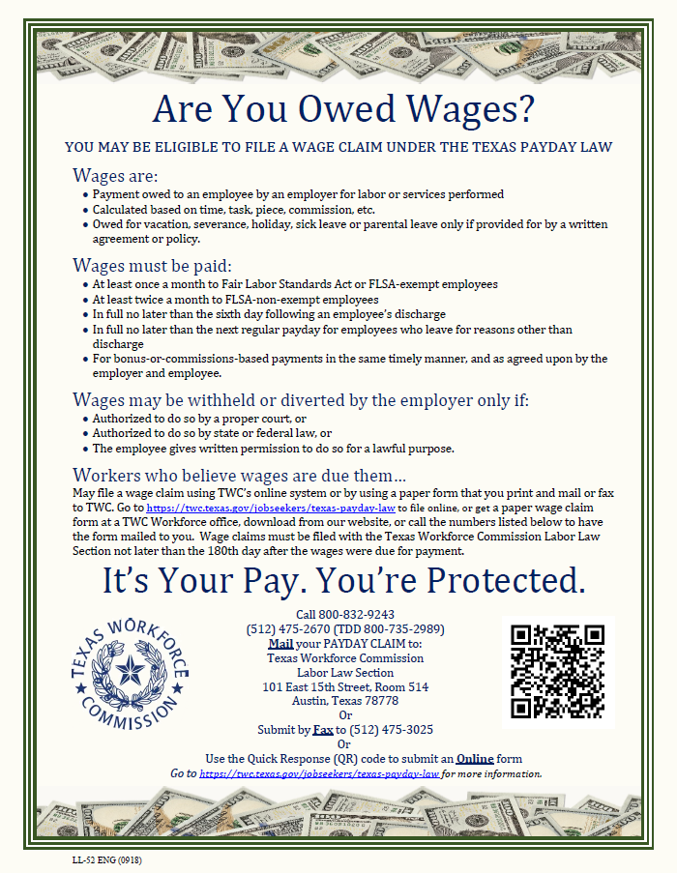
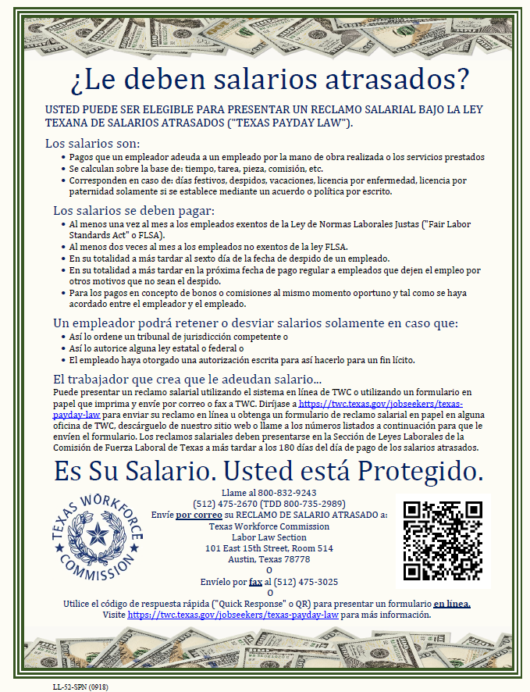
Are You Owed Wages

Slide 24



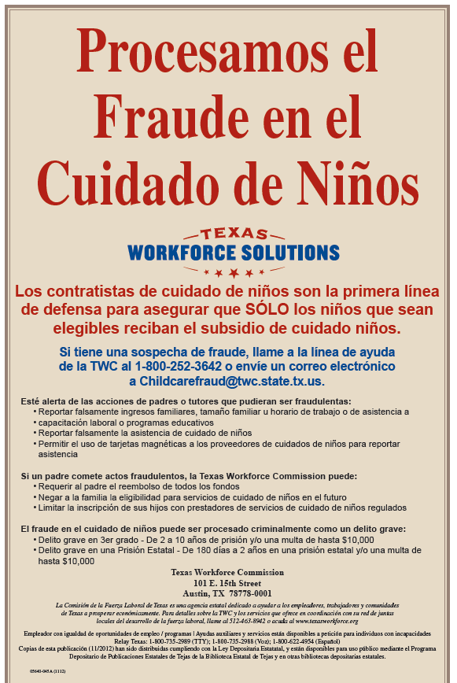
TWC Fraud, Waste, & Abuse and Child Care Fraud
Must be posted together

Slide 25
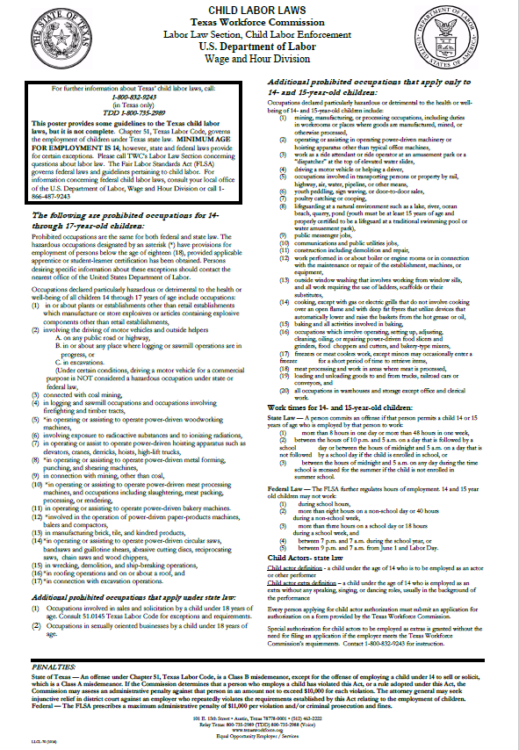
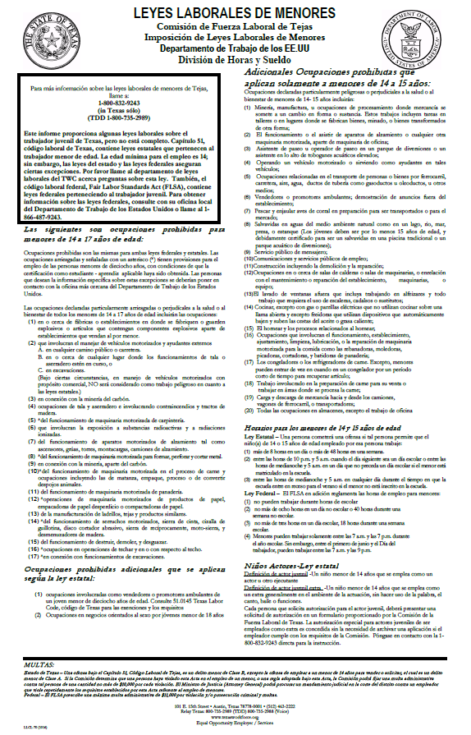
Child Labor Laws

Slide 26


IRS Earned Income Tax Credit

Slide 27
employee areas

Slide 28
WIOA Equal Opportunity is the Law

Slide 29
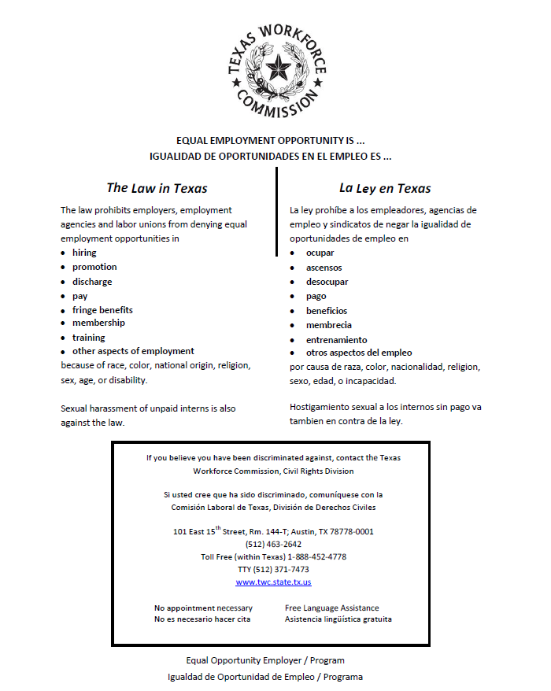
TWC Equal Employment Opportunity is the Law

Slide 30


Report Fraud, Waste, or Abuse

Slide 31

Reporting Workplace Violence

Slide 32
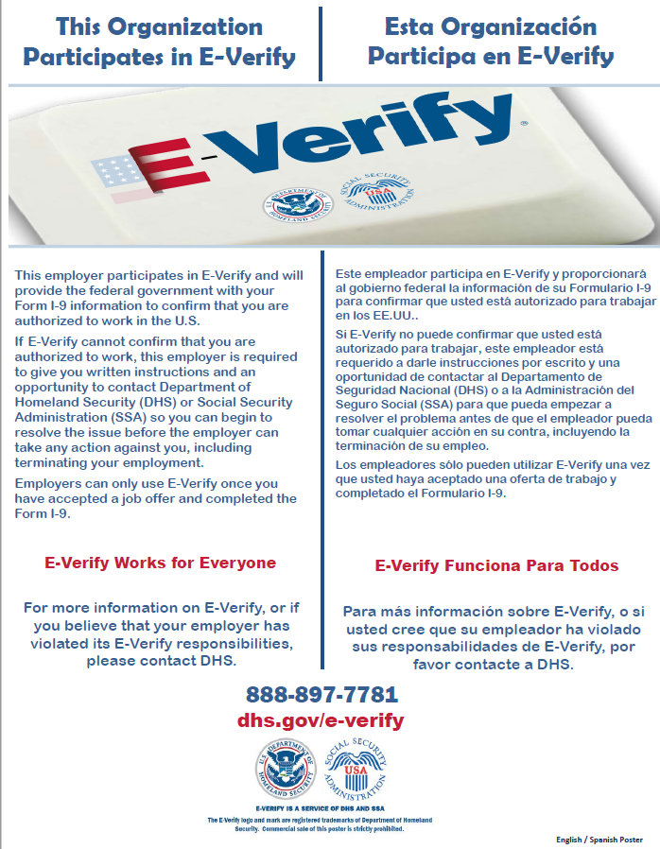
E-Verify

Slide 33
Fair Labor Standards Act

Slide 34


Family Medical Leave Act

Slide 35


Employee Polygraph Protection Act

Slide 36
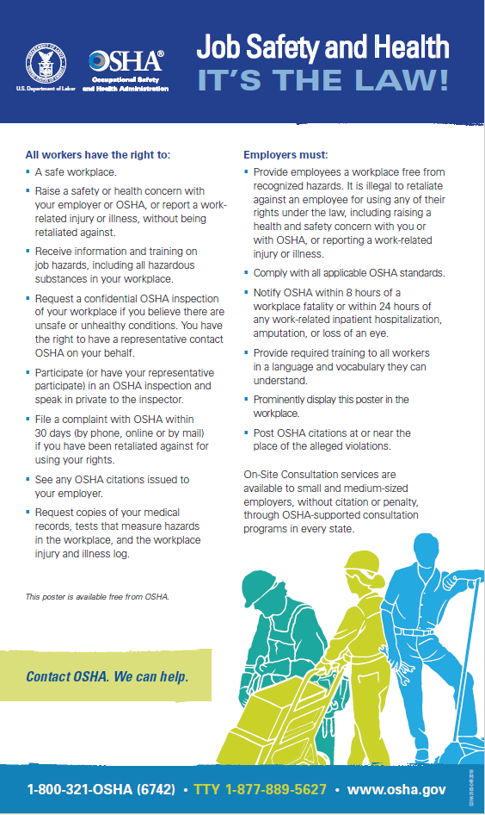
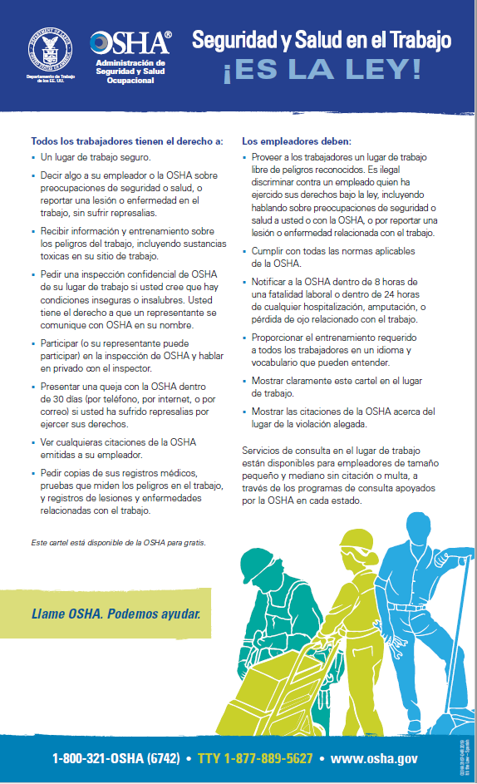
Occupation Safety and Health Act

Slide 37
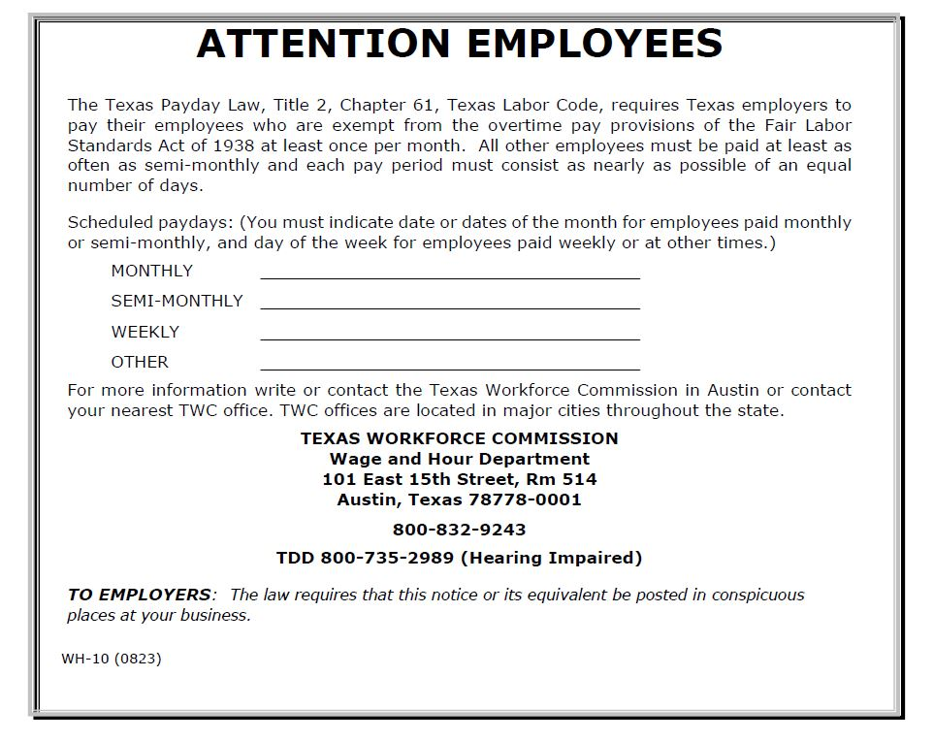
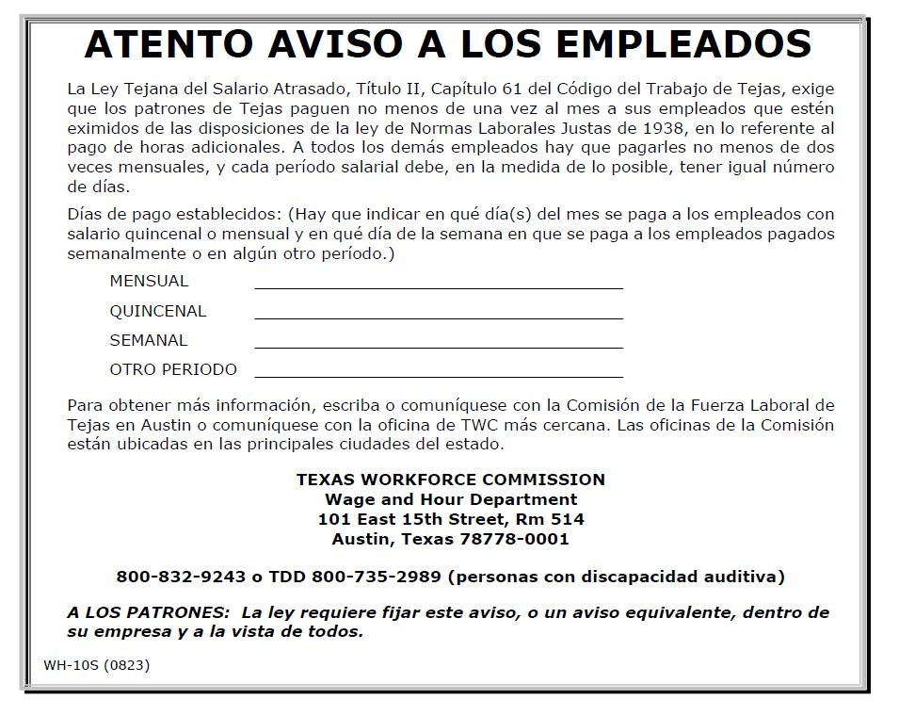
Texas Payday Law
Employers that do not participate in unemployment
Blanks must be completed, as appropriate

Slide 38

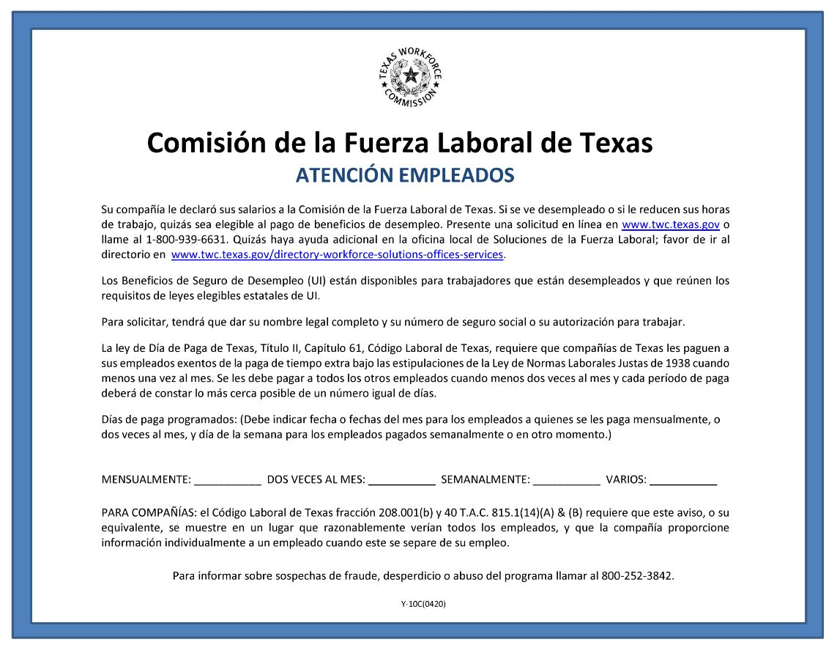
Texas Payday Law
Employers that do participate in unemployment
Blanks must be completed, as appropriate

Slide 39
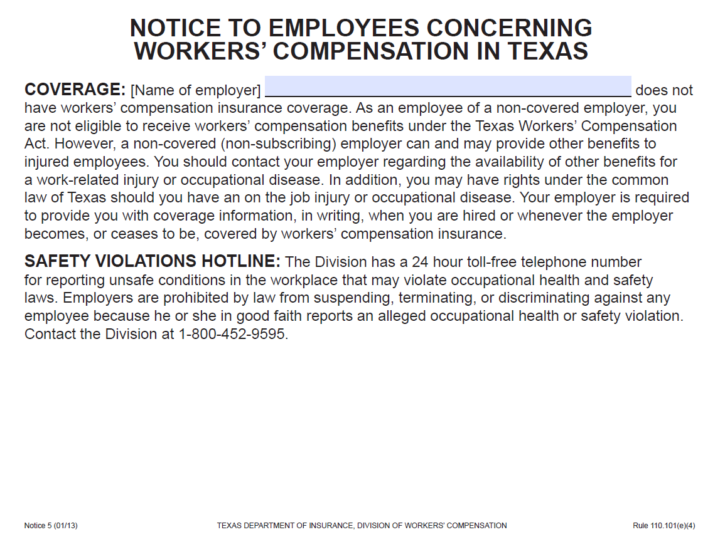
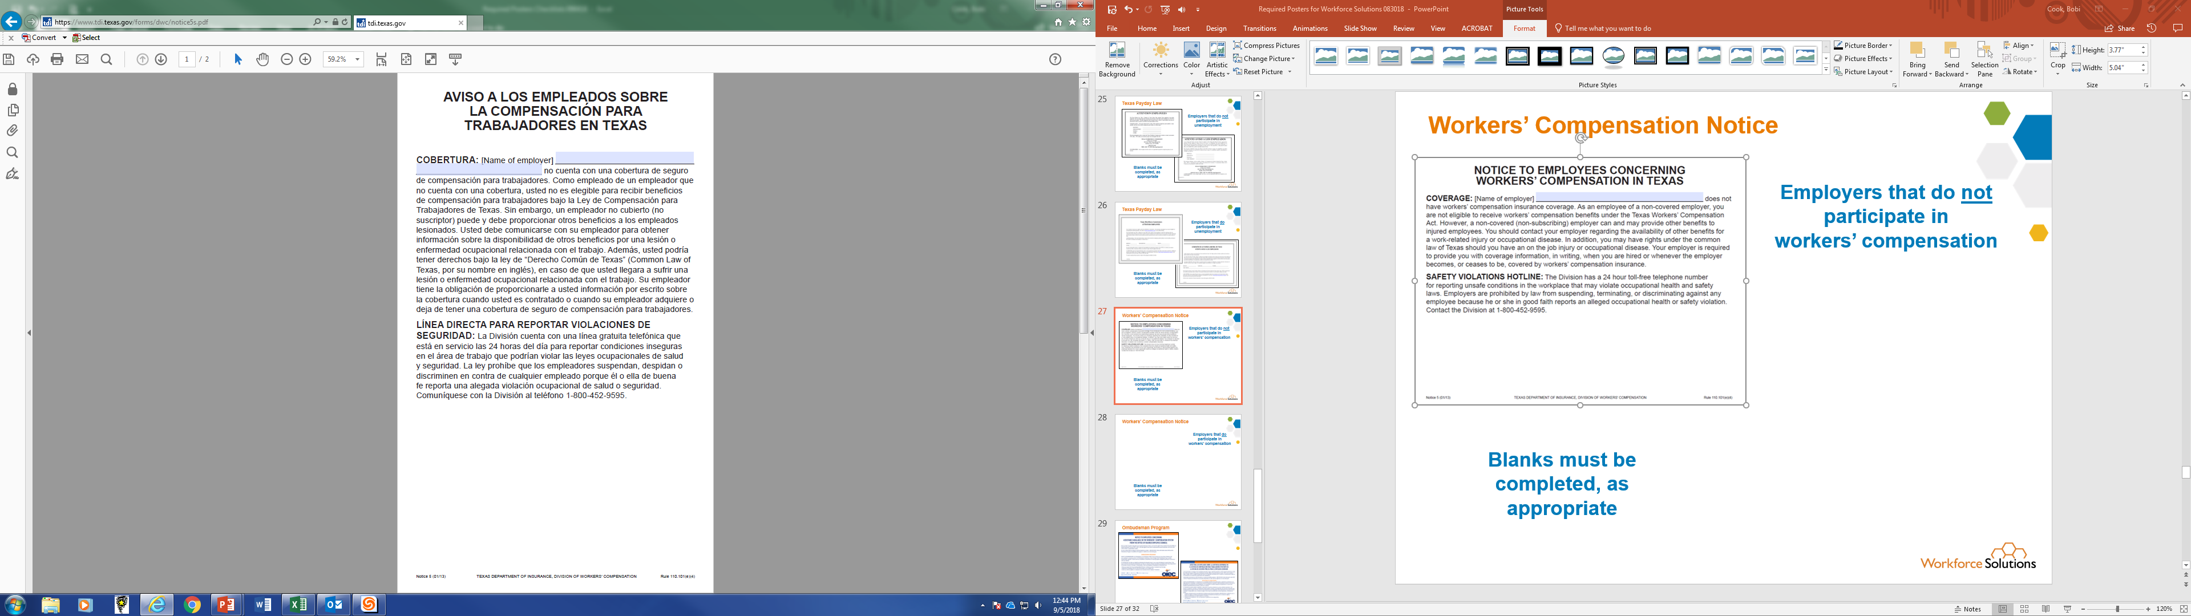
Workers’ Compensation Notice 5
Employers that do not participate in
workers’ compensation
Blanks must be completed, as appropriate

Slide 40
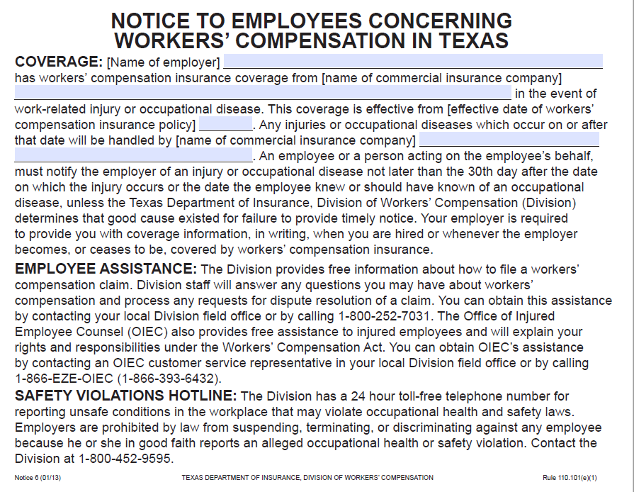
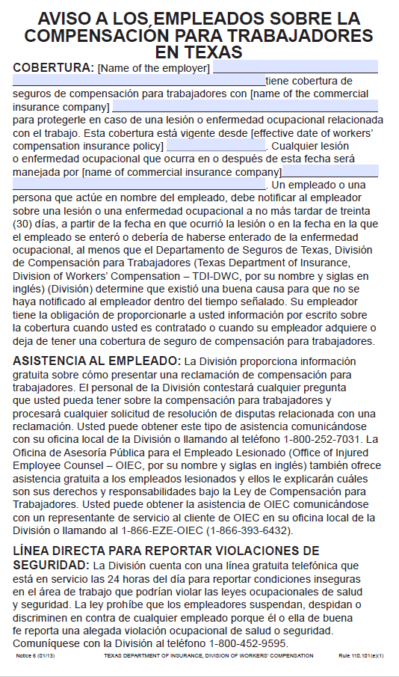
Workers’ Compensation Notice 6
Employers that do participate in
workers’ compensation
Blanks must be completed, as appropriate

Slide 41
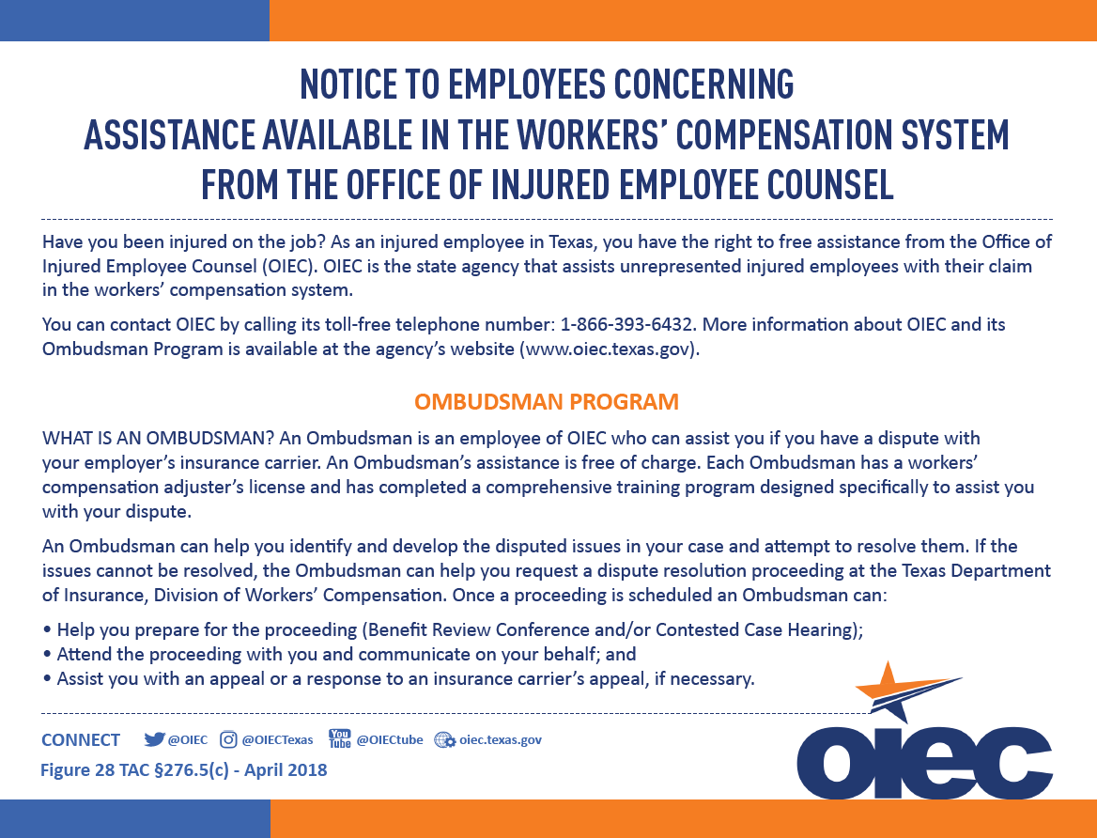
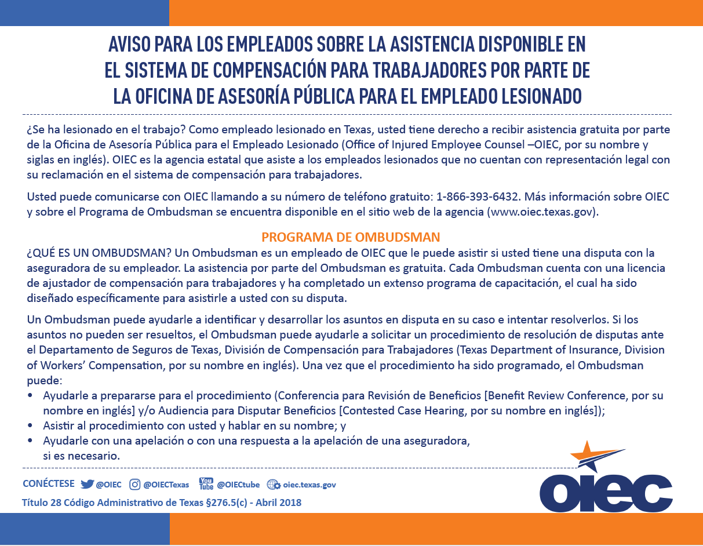
Ombudsman Program
Employers that do participate in
workers’ compensation

Slide 42

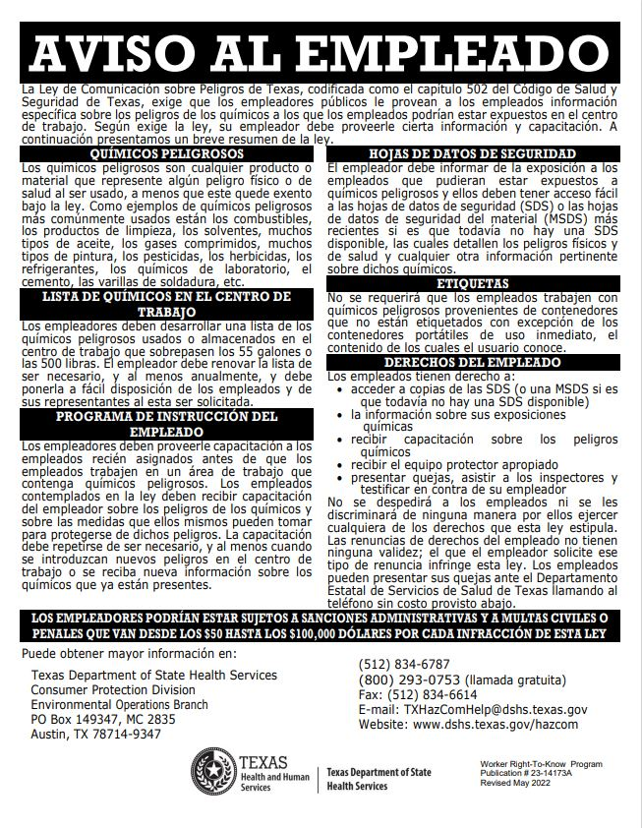
Worker Right to Know Notice

Slide 43

Uniformed Services Employment and Reemployment Rights Act
As an alternative to posting, this information may be provided directly to employees in either a paper or electronic format

Slide 44
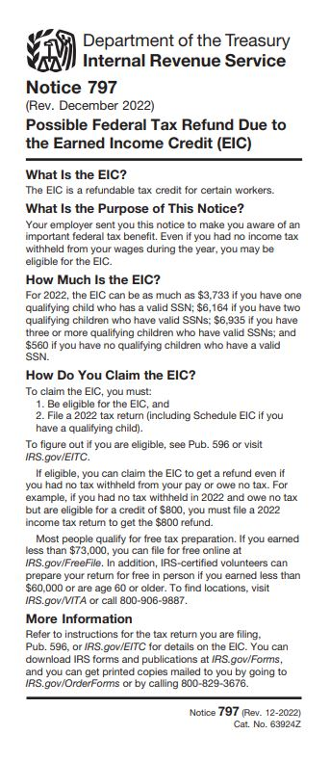
Earned Income Tax Credit
As an alternative to posting, this information may be provided directly to employees in either a paper or electronic format

Slide 45


Pay Transparency Nondiscrimination Provision

Slide 46
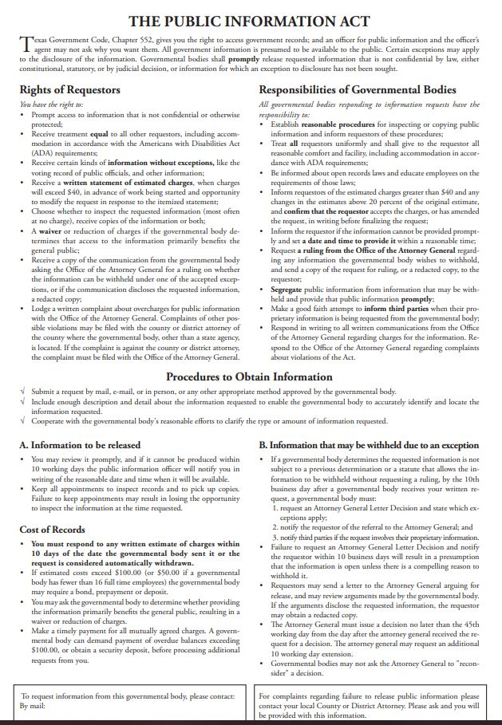
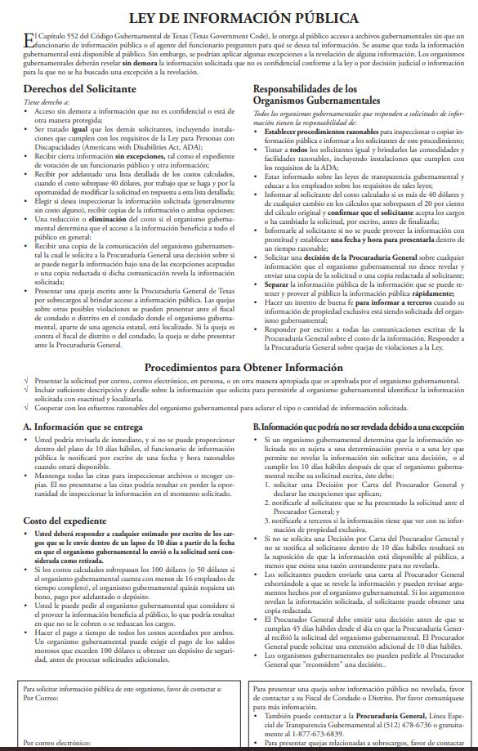
Open Records PIA

Slide 47
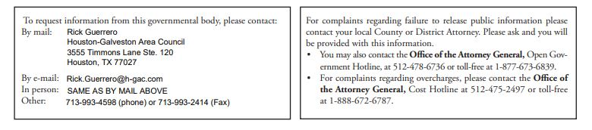
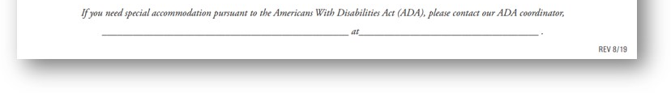
Open Records PIA (Continued)
Blanks must be completed, as appropriate
Intergovernmental Relations Director for Houston Galveston Area Council, Rick Guerrero will have his contact information posted for information request.
Contractor Equal Opportunity Officer will list their name, email and phone number for special accommodation request.

Slide 48


IER Right to Work Poster
If co-located with TWC

Slide 49
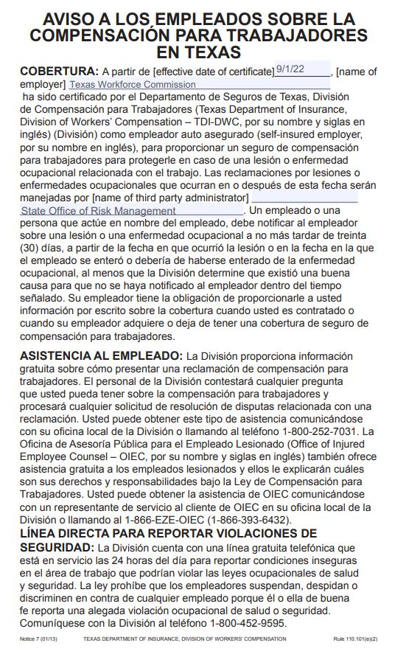
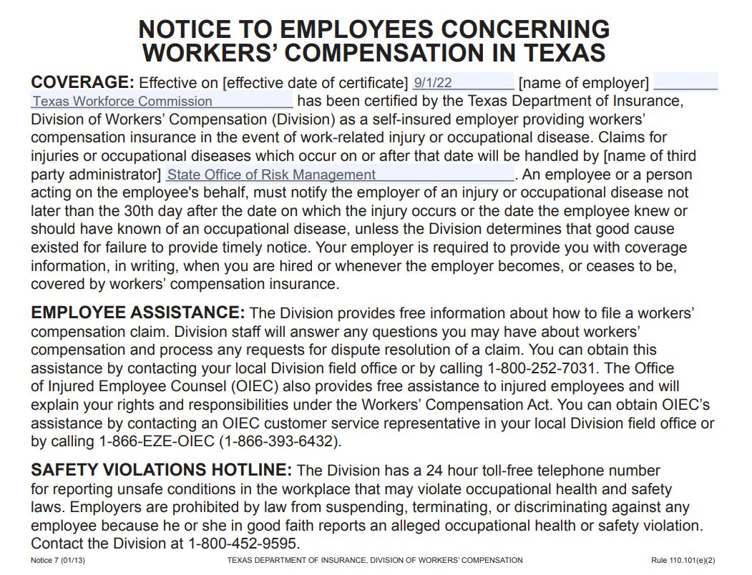
Worker’s Compensation Notice 7
Employers that are certified as self-insured by TDI; Or if
co-located with TWC

Slide 50

Fair Labor Standards Act (State and Government Employees)
If co-located with TWC

